Slide 1
Lucky Unicorn
[Luke Richardon]

Slide 2
Lucky Unicorn
Link to GitHub Repository: https://github.com/TheMale1/Lucky-Unicorn
Links to Trello board / project management tools: [here]
Link to final version of your program: [here]
Ensure you have made these links ‘public’ so that they are open to anyone, including the marker. The link to your program is the final outcome of this whole project – your finished program.

Slide 3
Describe relevant Implications 1:
Additional rows can be added by clicking in the last cell and then using the Tab key
Relevant implication | Describe the implication and give an example
Functionality | Functionality is making sure the program actually works. The code should still work even if the user inputs the wrong kind of answer. For example if the user entered ‘one’ instead of ‘1’, it would be expected that the code does not crash and gives the user another chance to input that information.
Usability | Usability is making the experience as smooth as possible for the user. There should be no glitches that hinder the users efforts to use the code. If there are error messages they should be clear and easy to understand.
Aesthetics | Aesthetics is making sure the final product looks presentable. It could use rows of equals signs to separate questions or to be used as dividers. There should be no great masses of plain text.
Notes:
Additional rows can be added by clicking in the last cell and then using the Tab key

Slide 4
Describe relevant Implications 2:
Additional rows can be added by clicking in the last cell and then using the Tab key
Relevant implication | Describe the implication and give an example
Social | Social implications include how the program will affect people. For example if you designed a program for gambling that had no limits or safeguards people could develop addictions or make unreasonable losses. You also need to make sure the code/script contains nothing offensive to religion, race, or orientation
Future Proofing | Future Proofing is making sure that the code is well laid out and organised so that you could easily come back at a later date and edit/modify it. Another programmer should be able to easily understand your code. Another programmer be able to understand the purpose and reasoning behind different sections of your program
Notes:
Additional rows can be added by clicking in the last cell and then using the Tab key

Slide 5
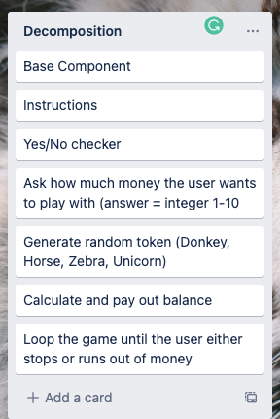
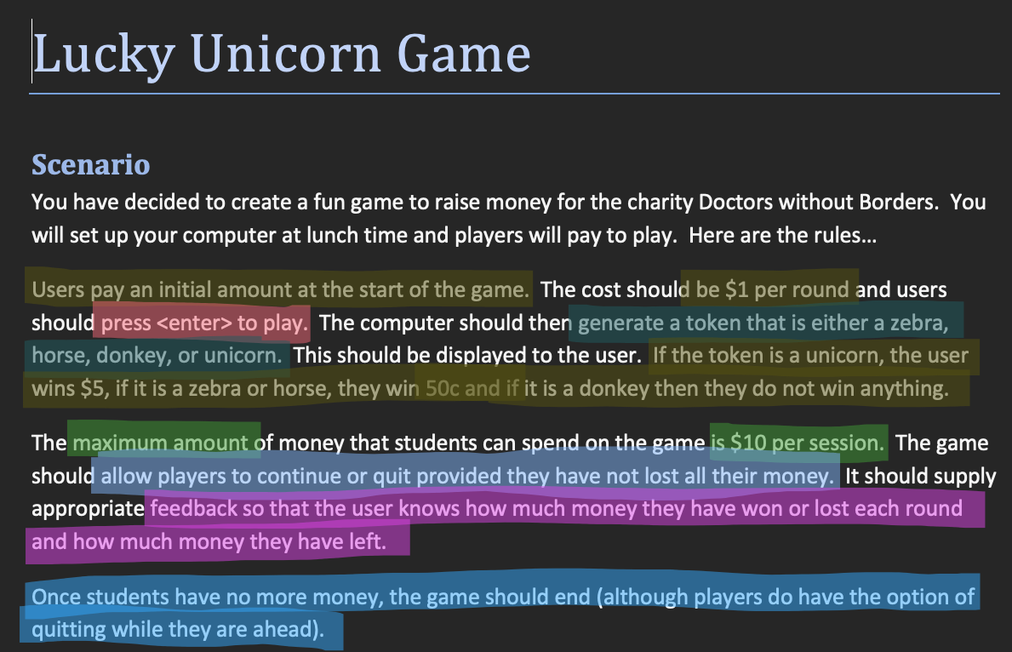
Decomposition:
Paste screenshots of your initial Trello board / task decomposition on this slide. If you have a long list, you might need to break it up into several slides.
Notes:
Paste screenshots of your initial Trello board / task decomposition on this slide. If you have a long list, you might need to break it up into several slides.

Slide 6
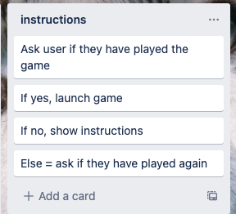
Component 1 (Yes/No Checker)

Slide 7
Yes/No Checker- Test Plan
Additional rows can be added by clicking in the last cell and then using the Tab key
Test Cases - input | Expected output
yes | Continue
Y | Continue
no | Continue
N | Continue
Maybe | Ask user to enter Yes/No
Notes:
Additional rows can be added by clicking in the last cell and then using the Tab key

Slide 8
Instructions Test Plan
Additional rows can be added by clicking in the last cell and then using the Tab key
Test Cases - input | Expected output
Have you played the game before? Maybe | Invalid answer. Please choose Yes/No
Have you played before? Yes | Game starts
Have you played before? No | Show instructions, then start game
Notes:
Additional rows can be added by clicking in the last cell and then using the Tab key

Slide 9
[Component name]: Trialling
NOTE: Trialling needs to happen for at least 2 of your components but is not necessary for ALL components.
Trialling is not the same as testing. Trialling is about finding different ways of building the same component. Show evidence of your trialling here. Select one of your trials for further development and give reasons for your choice.
Notes:
NOTE: Trialling needs to happen for at least 2 of your components but is not necessary for ALL components.
Trialling is not the same as testing. Trialling is about finding different ways of building the same component. Show evidence of your trialling here. Select one of your trials for further development and give reasons for your choice.

Slide 10
[Component name]: Testing
You must show the results of testing. For each component, include a screenshot proving it works. You can also include notes about each test.
Notes:
You must show the results of testing. For each component, include a screenshot proving it works. You can also include notes about each test.

Slide 11
Assembled Outcome Testing:
Show testing for your assembled outcome below. This should include a test plan followed by screenshot proof.
Notes:
Show testing for your assembled outcome below. This should include a test plan followed by screenshot proof.

Slide 12
Address relevant Implications:
Relevant implication | Explain how your final outcome addresses each implication

Slide 13
Version Control Evidence:
Your version control evidence should go here. This could be in the form of screenshots (both of your GitHub repository as well as your local project folder) as evidence of your incremental development.
Notes:
Your version control evidence should go here. This could be in the form of screenshots (both of your GitHub repository as well as your local project folder) as evidence of your incremental development.

Slide 14
Final Discussion:
Discuss how the information from planning, testing and trialling of components assisted in the development of a high-quality outcome.
Notes:
Discuss how the information from planning, testing and trialling of components assisted in the development of a high-quality outcome.

